Slide 1

HVAC Companies and their
Covid-19 initiatives
Parth Patel

Slide 2
Holistic Findings
Notes:
General findings summary
Holistic findings from the agencies and the various companies

Slide 3


HVAC and Covid-19
Intro: Transmission of Covid-19
Airborne transmission is definitely a factor
Facemasks help
Surface-to-surface might be less than initially expected
Air Conditioning is suspected to play a huge role in the spread of COVID-19
Improperly managed AC VS. Properly managed AC
Authoritative figures have recommendations for HVAC
ASHRAE recommendations are cited
CDC recommendations are cited
Notes:
So I didn’t include it however, I’m talking entirely about COVID spread indoors
So starting off with how COVID is transmitted. The different agencies like the CDC, WHO, and ASHRAE, they vary a little bit on the specific of the transmission, however they do generally agree with these 3 points.
Improperly managed AC can facilitate the spread…. Case study of restaurant in Hong Kong and call center in south korea
Properly managed AC can be the biggest defense you have …… This is seen in the case of hospitals
The authoritative figures in the space have recommendation for HVAC operation. And generally what I saw from the other companies that had COVID initiatives in HVAC, they all cited these authoritative figures.

Slide 4
HVAC and Covid-19 cont…
Successful Infection depends on:
Viral Load
Length of exposure
HVAC Solutions to tackle COVID
Primary emphasis: Increased air changes / ventilation
Secondary emphasis: Reduce amount of virus via HEPA filters, or UV/UVC lights
Within the HVAC IoT market, emerged two categories.
Automation for your HVAC to control air flow
I.e. 75F and BrainBox.ai
Monitoring for HVAC
Brezi!
Notes:
So just continuing my general findings summary, from research, I found mentioned over and over
The primary emphasis of using HVAC to tackle COVID falls on ….
Within Breezi’s playing field, I found that there were two general categories of products/services offered those that had some COVID initiative:

Slide 5




Companies with COVID initiatives
Notes:
Of the companies that I found had COVID 19 initiatives, these 4 seemed the strongest / stood out to me the most.
All of these companies are in the HVAC IoT sphere. Aside from 75F, all the rest seem to have a focus on providing monitoring services.
I would say 75F is more oriented towards providing automated systems rather than monitoring data
75F and mCloud are the two bigger companies
Senseware being in the middle
Talos is the smallest, likely smaller than breezi

Slide 6
75F
Started in 2012….
COVID 19 seminar takeaways
When it comes to virus exposure indoors, two things matter:
The concentration of virus particles per ft^3 of air: “Viral Load”
How long the virus stays in the air: “Length of exposure”
Case Study: South Korean Call center
1 sick employee infected all 94 others on same floor
HVAC recommendations from CDC, ASHRAE and others…
Flushing air from building before/after occupancy
Increase outside air (as much as possible)
Notes:
Within the webinar they also talked about the HVAC recommendations from various agencies and organizations such as CDC, ASHRAE.
Those recommendations are…
75F implemented those recommendations in their new product/service: epidemic mode

Slide 7

75F epidemic mode
Smart Purge
Flush all the air from the building 2 hours before & after occupancy
Maximum outside air flow possible enabled
Smart Enhanced Ventilation
Maximized fresh air intake possible by HVAC equipment & weather
Zone dampers, VAV boxes opened
Increased air changes / Increased ventilation
Sequence automatically updates with new CDC guidelines

Slide 8
Talos IoT
New company: Started in 2019
Background:
For building owners/managers; Constantly monitors and alerts you when HVAC is having a problem
CEO calls it: “Fitbit for the air conditioner”
COVID initiatives:
Has no COVID initiatives on their site
Limited Media Ads (single article):
Provide HVAC monitoring/insights, and UV Light Monitoring
They monitor:
HVAC efficiency
Heating/cooling performance
Compressor performance
Condenser fan
Refrigerant leak
Dirty coil/filters
UV Light monitoring
Notes:
This is a new company, it started in 2019 based on the CEO. It doesn’t have a facebook, no crunchbase. Just linkedin and twitter, they joined twitter in March 2020
Just some background info,
They say their product is for building owners and managers
The CEO called it… in an interview that was done
I wouldn’t necessarily say that they changed their business for COVID, since they just started
I found a single article written about an interview with him where he talked about how his product/service can serve as a powerful solution to COVID
Their company provides things such as HVAC monitoring, UV light monitoring.
They seem VERYY similar to breezi, but these are some images I got from their website….

Slide 9
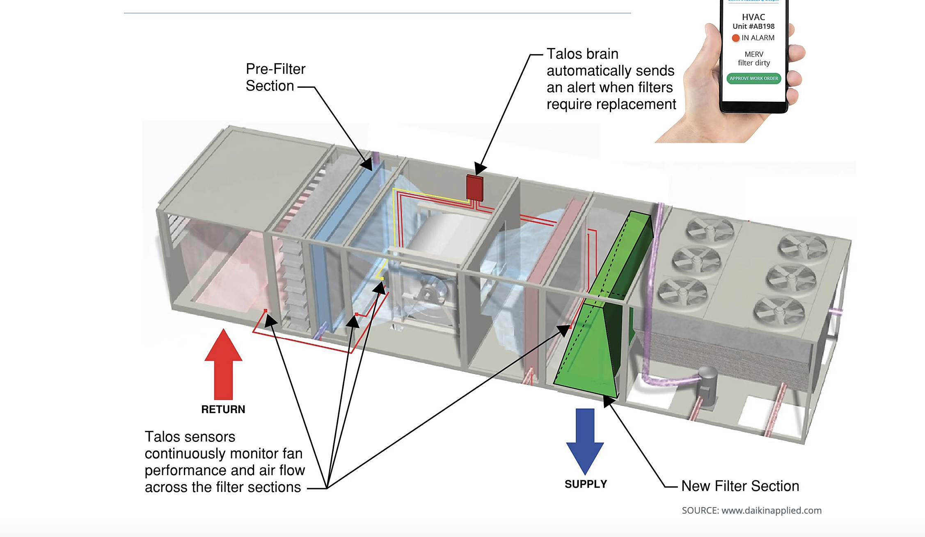
Filter Monitoring Solution

Slide 10
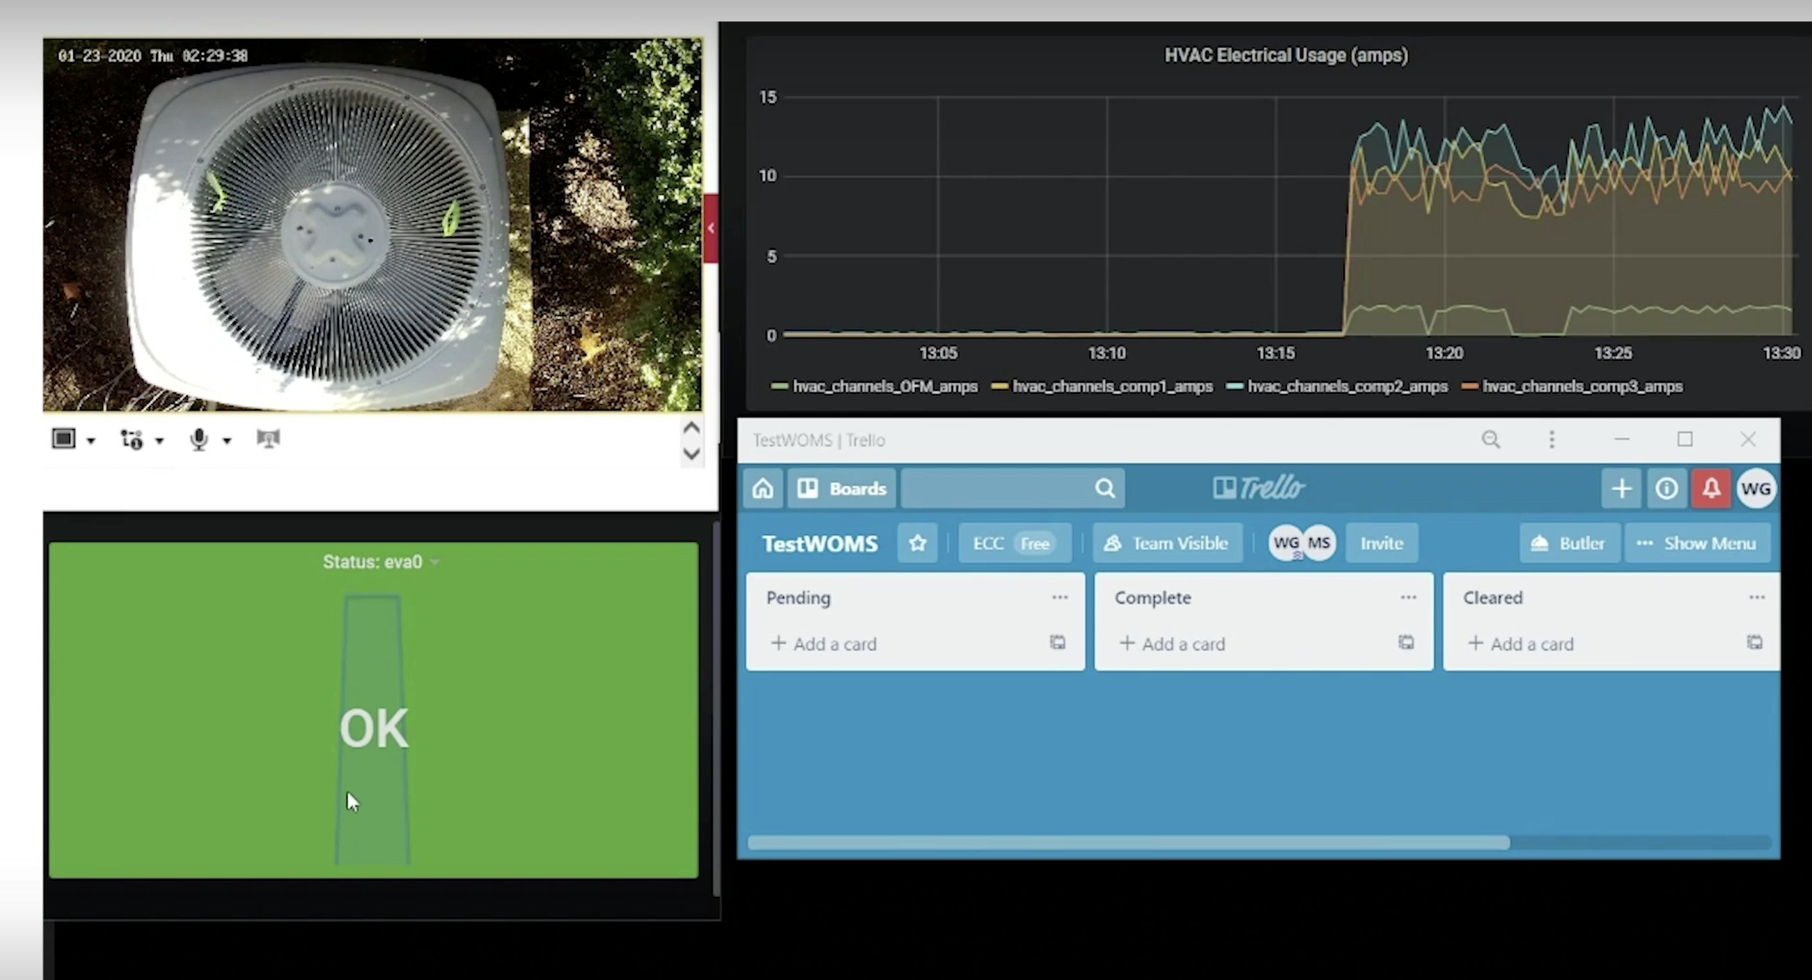
Demo Image of HVAC Monitoring platform
Notes:
The next two companies were not as closely related to breezi as talos and 75F, however I thought they were worth sharing.
I found that a lot of companies just remarketing their existing products to COVID with simple stuff like
New webpage
Resource center on their site
Blogs
And etc….

Slide 11
mCloud corp
Background
Founded 2010
Does business in sectors of AI, analytics, and IoT; Also present in HVAC IoT sphere
Value they provide: “managing your indoor air quality”
COVID Initiatives (www.mcloudcorp/backtobusiness.com)
Provide all-in-one solutions for Retail, Restaurants, Long-term care, Commercial
Provide optional air quality filtration to ”capture and kill” viruses (hospital grade)
COVID 19 resource center, blogs, informative products
Marketing scheme
Not much change to their original business. Different marketing and special section of website
Notes:
Company was founded in 2010.
Is a Canadian company that has an IPO, multiple acquisitions and a valuation of 111 million
They do business a lot of related areas, they are also present in the HVAC IoT sector.
The main value they provide here is: “managing your indoor air quality”
COVID initiatives are the ways they changed/adapted to COVID
They gave COVID 19 its own space on their website
In that section they specifically point out, “We provide all-in-one solutions for Retail, restaurants, ….
Provide optional air filtration to capture and kill viruses
They also, have a COVID resource center, blogs, and info product such as pdf ebooks to capture and audience on their site
I’m not sure about the optional air filtration system, but it seems as if there was not much change to their original business. Just re-marketing and giving COVID its own section on their site

Slide 12
Senseware.co
Background
Founded 2013
Is an IoT platform. Has a scalable modular IoT setup allows for quick deployment
More Orientation towards monitoring
COVID Initiatives (www.senseware.co/covid-19)
Special COVID19 cleanroom grade airborne IAQ and HVAC solution
Published white paper: “Using IoT environmental sensing to reopen spaces"
Marketing scheme
Like mCloud corp, Senseware simply re-marketed existing product/service to COVID19
Notes:
The company is on the leading edge of IoT sensors
Their solutions consist of: Sensors, analytics on data, Retrofit control .
The company’s solutions are similar to mCloudCorp,

Slide 13
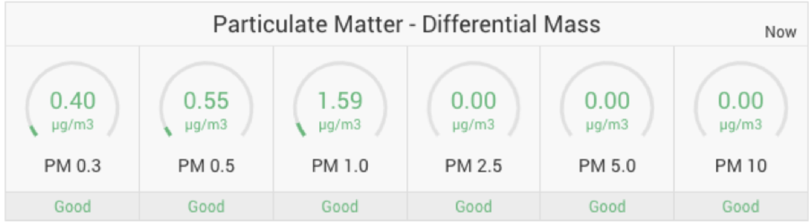
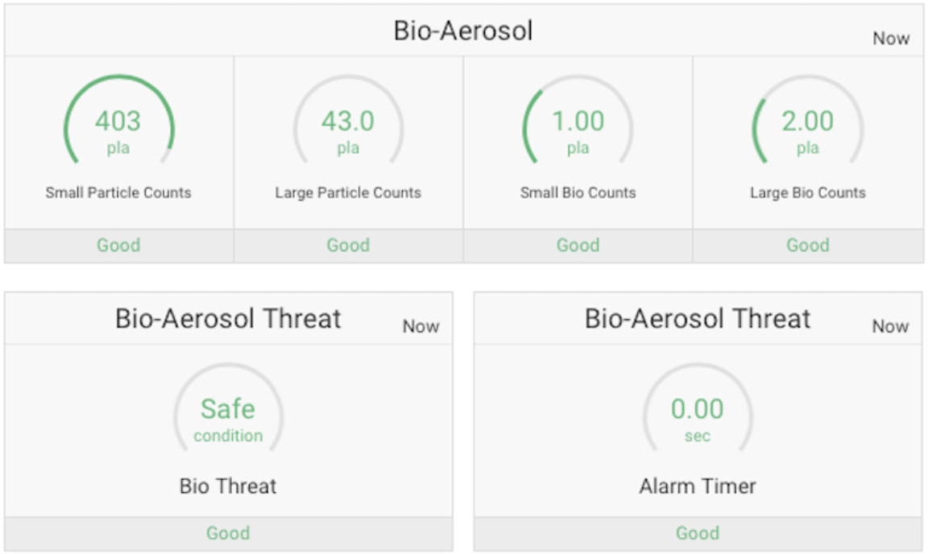
Provides Particulate matter sensing for IAQ monitoring
Helps with detecting potential threats from infectious Aerosols i.e. COVID19

Slide 14
Possible Ideas for Breezi
Scenario 1: Customer is buying from Breezi for reason X. Assuming normal installation and no specialization for COVID. During the Sales Pitch: Breezi can talk about COVID19 era benefits
This is continuing current modus operandi
”Airpulse can monitor air flow, air quality in the rooms….” “Airpulse can monitor the amount of fresh air entering / amount of air changes.”
2) Scenario 2: Customer is interested in buying product specifically for COVID times. This is assuming that the customer was drawn to Breezi for a COVID solution.
This will require a branched off section of Breezi
Notes:
From what I gathered from what I looked up, How could breezi benefit from or adjust to COVID19
Case 1 would be continue as normal, but I guess just mention to clients the ways breezi can help alievate the pain from COVID
Case 2 would be remarketing as the other companies have done.

Slide 15

Ideas COVID cont…
Scenario 2 continued : Will require some website tweaking, simple marketing video
There is nothing about COVID on the website (there is also no link to BreeziPro site from the Breezi.io site)
Will require customer education: New clients might not see the product and think, “this would be applied ….”
Simple marketing video could highlight setup of device for health monitoring of air filters
Notes:
Will require customer education: New clients might not see the product and think, “this could be applied to help me for COVID, This could help me see the health of filters”. Also customers might require education of how clean filters, air recycling, and etc… combats COVID spread

Slide 16


